Slide 1

Machine Learning Accelerator
Computer Vision

Slide 2
Course Overview
MLA - Computer Vision Topics
Intro to ML and Computer Vision (CV)
Training Neural Networks and Convolutional Neural Networks (CNN)
Classic CNN Architectures: LeNet, AlexNet, VGG and ResNet
Final Project: Image Classification
Object Detection: Bounding Box, R-CNN and YOLO
Semantic Segmentation: FCN and U-Net
Transfer Learning and AutoML

Slide 3


ML Applications
Problem type
Description
Example
Ranking
Helping users find the most relevant items
Fruit freshness
Recommendation
Giving users the items they may be most interested in
Before
After
Classification
Figuring out what category does an item belongs to
Regression
Predicting a numerical value of an item
Clustering
Putting similar items together
Good
Damage
Serious Damage
Decay
Anomaly Detection
Finding uncommon items

Slide 4
Image Augmentation
To produce similar, but different, training examples
For improving model’s capability for generalization
Common methods:
Resizing (with different scales and ratios)
Cropping and flipping
Changing color, brightness
etc.
More details

Slide 5
Data Splitting
Training - Validation - Test Datasets
Original set
Shuffle the dataset before the split!
Training set
Test set
Training set
Validation set
Test set
Training, tuning, and evaluation
Machine learning algorithm
Model
More details.
Final performance estimate

Slide 6
Classification - Accuracy
Prediction
Positive
Negative
Accuracy*: The percent (ratio) of cases classified correctly:
$$Accuracy= \frac{TP+TN}{TP+FP+FN+TN }$$
$Accuracy= \frac{19+3}{19+1+2+3}$ = 0.88
*$0 (\text{bad}\text{)}≤Accuracy≤1\text{ (}\text{good}\text{)}$
(TP)
True Positive
(FN)
False Negative
Positive
19
2
True State
(FP)
False Positive
(TN)
True Negative
Negative
1
3

Slide 7
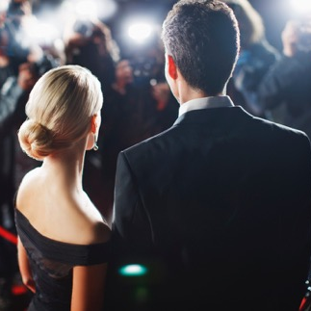

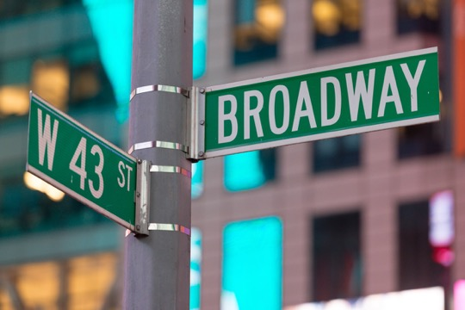
Computer Vision Tasks
1. Image Classification: What category does this image belong to?
Who
What
Where
Source: Amazon Rekognition

Slide 8
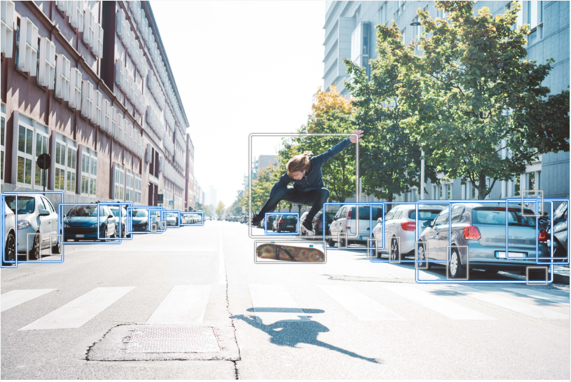
Computer Vision Tasks
2. Object Detection: Where are the locations of detected objects?
Person 98.3%
Car 98.8%
Source: Amazon Rekognition

Slide 9
Computer Vision Tasks
3. Semantic Segmentation: What are the boundaries of detected objects?
Source: Amazon Ground Truth

Slide 10


Image Representation
Images are made of pixels, pixels values between 0 and 255.
Two common types:
“RED”
“GREEN”
Grayscale Image:
Single channel
Pixels values between 0-255
0: Darkest intensity
255: Brightest intensity
Color Image:
3 channels
Red, Green and Blue
RGB is a common representation
Pixels values between 0-255
”BLUE”

Slide 11
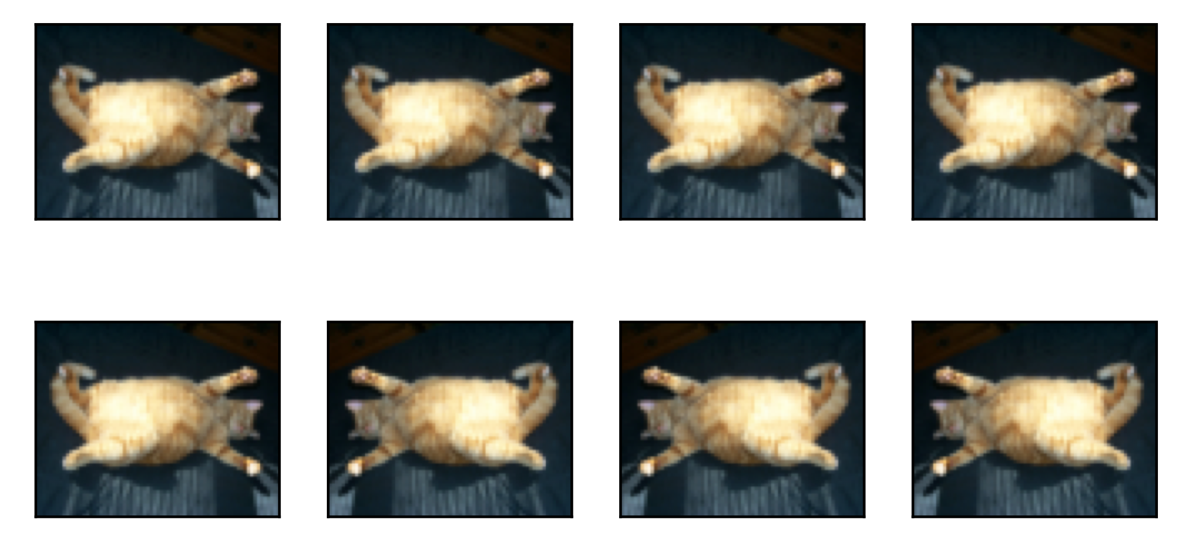
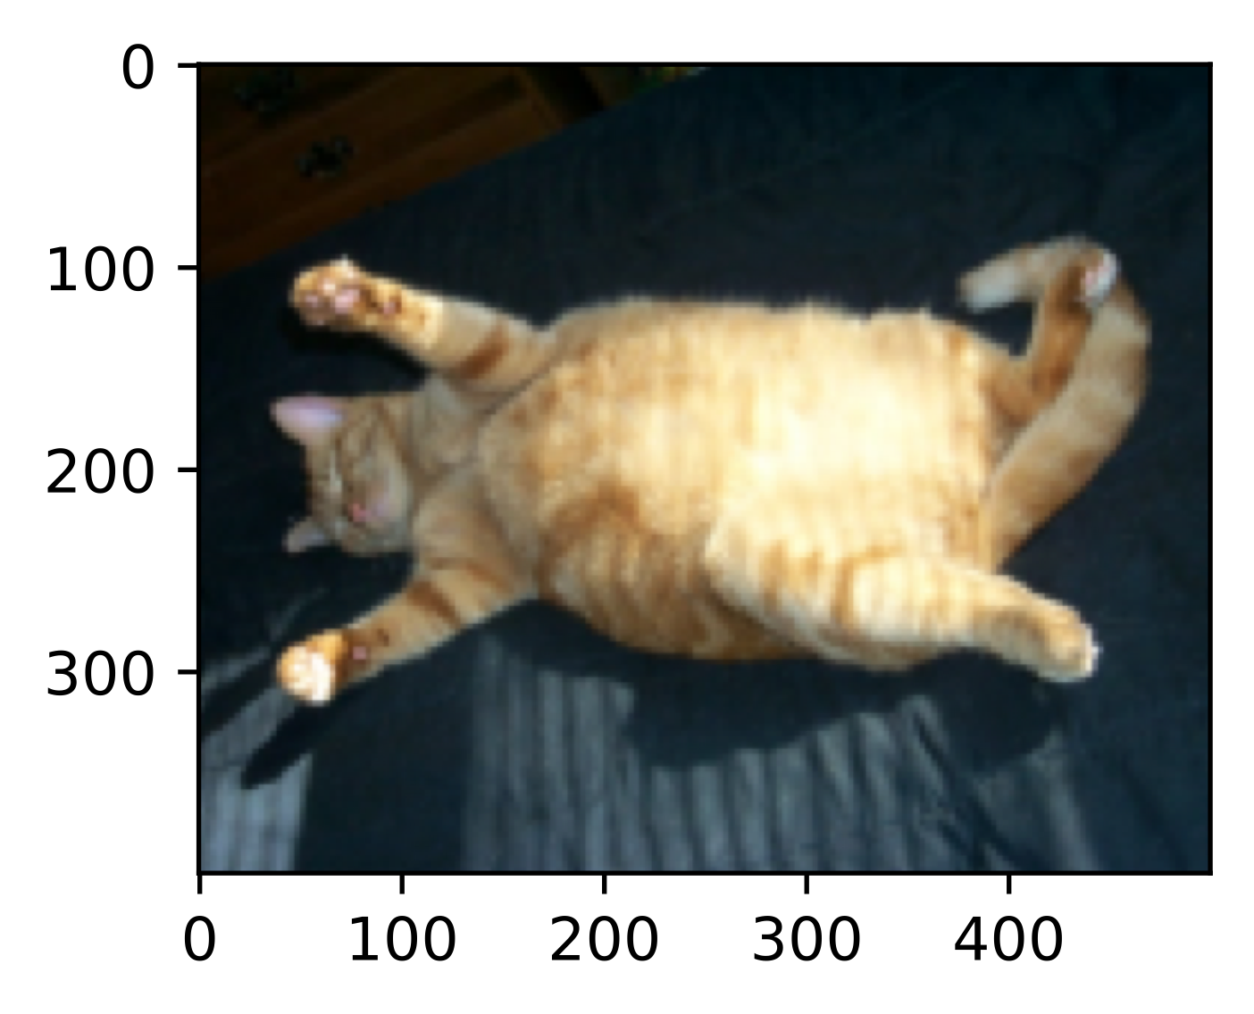
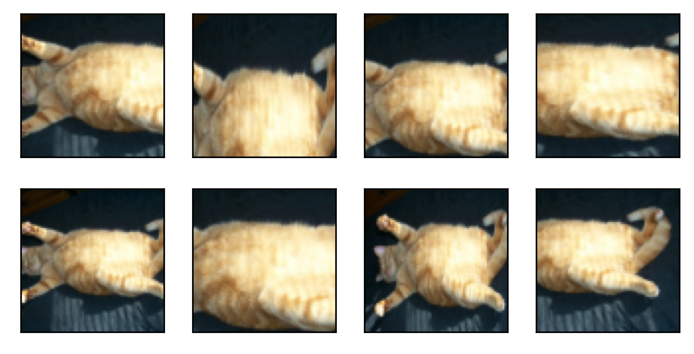
Image Augmentation
Cropping and flipping

Slide 12
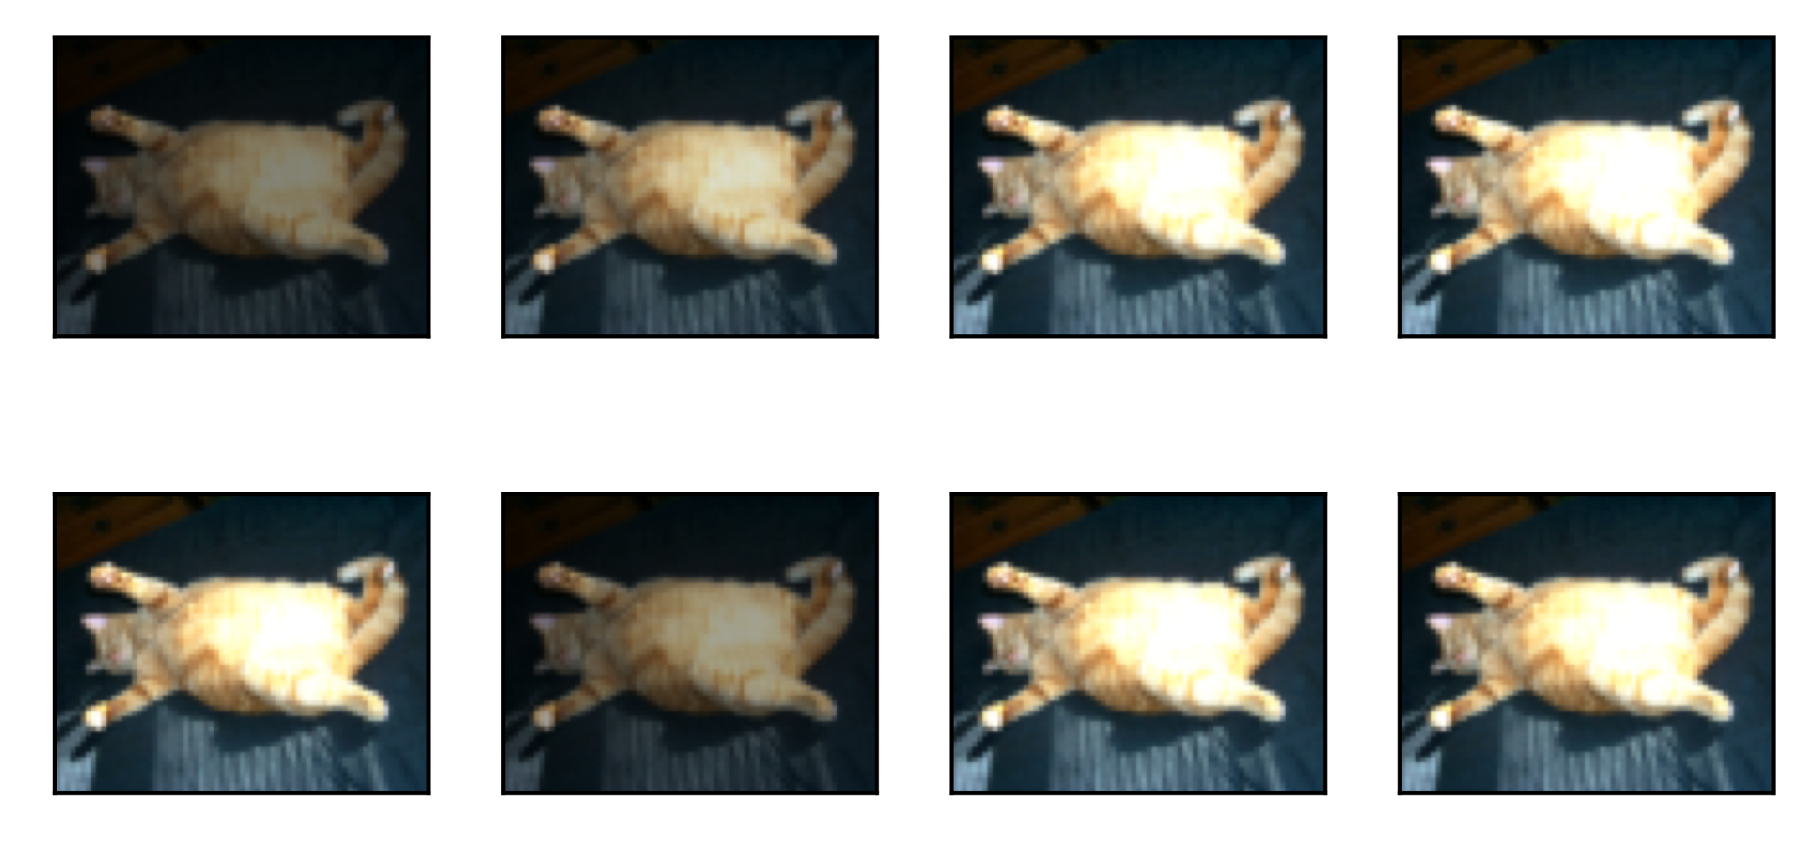
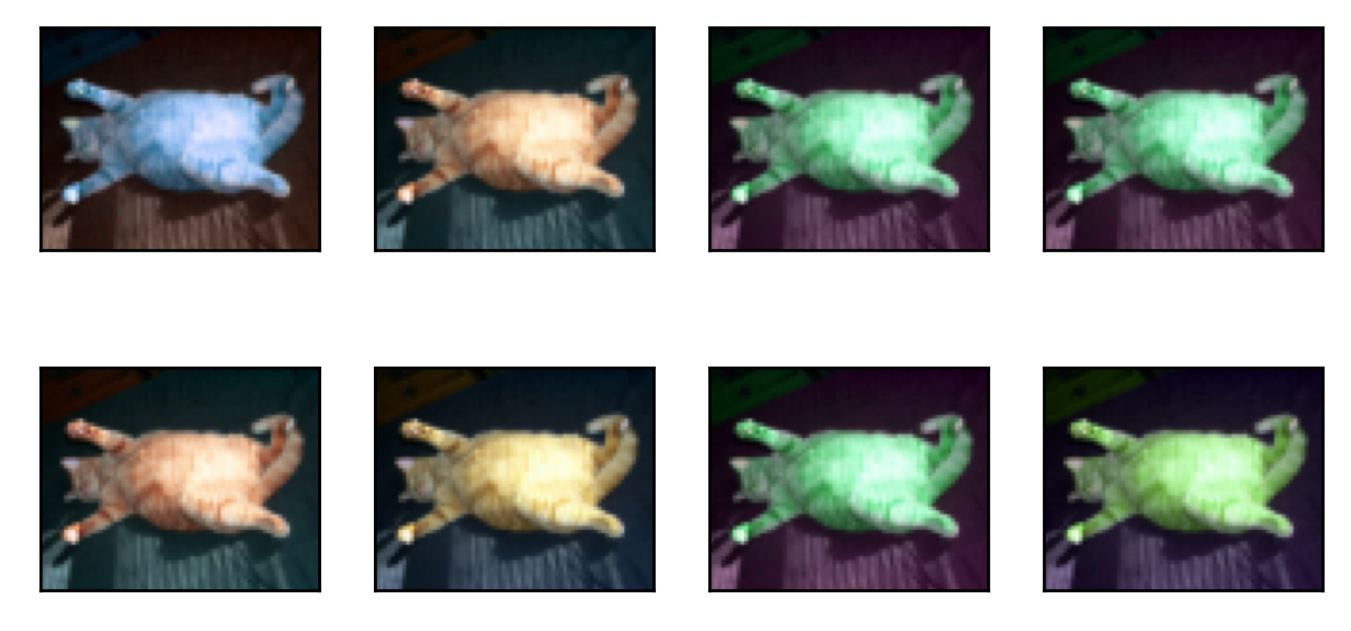
Image Augmentation
Changing color and brightness

Slide 13
Image Representation
On a N x M grayscale image, Im (M: # of rows, N: # of columns)
Columns
Im [m, n] => m pixels down, n pixels right
112 | 103 | 121 | 99 | 76 | 45 | 44 | 61
98 | 123 | 131 | 132 | 74 | 49 | 45 | 66
157 | 158 | 165 | 134 | 78 | 51 | 52 | 59
145 | 143 | 134 | 131 | 124 | 121 | 125 | 123
141 | 141 | 143 | 92 | 91 | 80 | 83 | 88
142 | 145 | 151 | 93 | 88 | 86 | 85 | 79
223 | 221 | 225 | 226 | 221 | 235 | 222 | 231
209 | 201 | 214 | 216 | 226 | 237 | 231 | 230
Rows
Im [0, 0]
Im [M-1, N-1]

Slide 14
Color Images
On a N x M x 3 color image, Im
N: # of rows,
M: # of columns,
3 channels
112 | 103 | 121 | 99 | 76 | 45 | 44 | 61
98 | 123 | 131 | 132 | 74 | 49 | 45 | 66
157 | 158 | 165 | 134 | 78 | 51 | 52 | 59
145 | 143 | 134 | 131 | 124 | 121 | 125 | 23
141 | 141 | 143 | 92 | 91 | 80 | 83 | 88
142 | 145 | 151 | 93 | 88 | 86 | 85 | 79
223 | 221 | 225 | 226 | 221 | 235 | 222 | 231
209 | 201 | 214 | 216 | 226 | 237 | 231 | 230
98 | 91 | 76 | 75 | 65 | 65 | 54 | 71
98 | 123 | 131 | 132 | 74 | 49 | 45 | 76
157 | 158 | 165 | 134 | 78 | 51 | 52 | 72
145 | 143 | 134 | 131 | 124 | 121 | 125 | 22
141 | 141 | 143 | 92 | 91 | 80 | 83 | 21
142 | 145 | 151 | 93 | 88 | 86 | 85 | 27
223 | 221 | 225 | 226 | 221 | 235 | 222 | 67
209 | 201 | 214 | 216 | 226 | 237 | 231 | 66
112 | 103 | 121 | 99 | 76 | 45 | 44 | 61
98 | 123 | 131 | 132 | 74 | 49 | 45 | 66
157 | 158 | 165 | 134 | 78 | 51 | 52 | 59
145 | 143 | 134 | 131 | 124 | 121 | 125 | 123
141 | 141 | 143 | 92 | 91 | 80 | 83 | 88
142 | 145 | 151 | 93 | 88 | 86 | 85 | 79
223 | 221 | 225 | 226 | 221 | 235 | 222 | 231
209 | 201 | 214 | 216 | 226 | 237 | 231 | 230
Im [m, n, c] :
m pixels down,
n pixels right,
c : 0,1, or 2 (“R”, “G”, or “B”)
B
G
B
R
G
R

Slide 15
Color Images
On a N x M x 3 color image, Im
N: # of rows,
M: # of columns,
3 channels
112 | 103 | 121 | 99 | 76 | 45 | 44 | 61
98 | 123 | 131 | 132 | 74 | 49 | 45 | 66
157 | 158 | 165 | 134 | 78 | 51 | 52 | 59
145 | 143 | 134 | 131 | 124 | 121 | 125 | 23
141 | 141 | 143 | 92 | 91 | 80 | 83 | 88
142 | 145 | 151 | 93 | 88 | 86 | 85 | 79
223 | 221 | 225 | 226 | 221 | 235 | 222 | 31
209 | 201 | 214 | 216 | 226 | 237 | 231 | 30
98 | 91 | 76 | 75 | 65 | 65 | 54 | 71
98 | 123 | 131 | 132 | 74 | 49 | 45 | 76
157 | 158 | 165 | 134 | 78 | 51 | 52 | 72
145 | 143 | 134 | 131 | 124 | 121 | 125 | 22
141 | 141 | 143 | 92 | 91 | 80 | 83 | 21
142 | 145 | 151 | 93 | 88 | 86 | 85 | 27
223 | 221 | 225 | 226 | 221 | 235 | 222 | 67
209 | 201 | 214 | 216 | 226 | 237 | 231 | 66
43 | 103 | 121 | 129 | 176 | 145 | 144 | 162
8 | 123 | 131 | 132 | 74 | 49 | 45 | 166
157 | 158 | 165 | 134 | 78 | 51 | 52 | 159
145 | 143 | 134 | 131 | 124 | 121 | 125 | 123
141 | 141 | 143 | 92 | 91 | 80 | 83 | 255
142 | 145 | 151 | 93 | 88 | 86 | 85 | 77
223 | 221 | 225 | 226 | 221 | 235 | 222 | 221
209 | 201 | 214 | 216 | 226 | 237 | 231 | 230
Im [0, 0, 0] => 43
B
G
B
R
G
R

Slide 16
Color Images
On a N x M x 3 color image, Im
N: # of rows,
M: # of columns,
3 channels
112 | 103 | 121 | 99 | 76 | 45 | 44 | 61
98 | 123 | 131 | 132 | 74 | 49 | 45 | 66
157 | 158 | 165 | 134 | 78 | 51 | 52 | 59
145 | 143 | 134 | 131 | 124 | 121 | 125 | 23
141 | 141 | 143 | 92 | 91 | 80 | 83 | 88
142 | 145 | 151 | 93 | 88 | 86 | 85 | 79
223 | 221 | 225 | 226 | 221 | 235 | 222 | 31
209 | 201 | 214 | 216 | 226 | 237 | 231 | 30
98 | 91 | 76 | 75 | 65 | 65 | 54 | 71
98 | 123 | 131 | 132 | 74 | 49 | 45 | 76
157 | 158 | 165 | 134 | 78 | 51 | 52 | 72
145 | 143 | 134 | 131 | 124 | 121 | 125 | 22
141 | 141 | 143 | 92 | 91 | 80 | 83 | 21
142 | 145 | 151 | 93 | 88 | 86 | 85 | 27
223 | 221 | 225 | 226 | 221 | 235 | 222 | 67
209 | 201 | 214 | 216 | 226 | 237 | 231 | 66
43 | 103 | 121 | 129 | 176 | 145 | 144 | 162
8 | 123 | 131 | 132 | 74 | 49 | 45 | 166
157 | 158 | 165 | 134 | 78 | 51 | 52 | 159
145 | 143 | 134 | 131 | 124 | 121 | 125 | 123
141 | 141 | 143 | 92 | 91 | 80 | 83 | 255
142 | 145 | 151 | 93 | 88 | 86 | 85 | 77
223 | 221 | 225 | 226 | 221 | 235 | 222 | 221
209 | 201 | 214 | 216 | 226 | 237 | 231 | 230
Im [0, 0, 0] => 43
Im [0, 0, 1] => 98
B
G
B
R
G
R

Slide 17
Color Images
On a N x M x 3 color image, Im
N: # of rows,
M: # of columns,
3 channels
112 | 103 | 121 | 99 | 76 | 45 | 44 | 61
98 | 123 | 131 | 132 | 74 | 49 | 45 | 66
157 | 158 | 165 | 134 | 78 | 51 | 52 | 59
145 | 143 | 134 | 131 | 124 | 121 | 125 | 23
141 | 141 | 143 | 92 | 91 | 80 | 83 | 88
142 | 145 | 151 | 93 | 88 | 86 | 85 | 79
223 | 221 | 225 | 226 | 221 | 235 | 222 | 31
209 | 201 | 214 | 216 | 226 | 237 | 231 | 30
98 | 91 | 76 | 75 | 65 | 65 | 54 | 71
98 | 123 | 131 | 132 | 74 | 49 | 45 | 76
157 | 158 | 165 | 134 | 78 | 51 | 52 | 72
145 | 143 | 134 | 131 | 124 | 121 | 125 | 22
141 | 141 | 143 | 92 | 91 | 80 | 83 | 21
142 | 145 | 151 | 93 | 88 | 86 | 85 | 27
223 | 221 | 225 | 226 | 221 | 235 | 222 | 67
209 | 201 | 214 | 216 | 226 | 237 | 231 | 66
43 | 103 | 121 | 129 | 176 | 145 | 144 | 162
8 | 123 | 131 | 132 | 74 | 49 | 45 | 166
157 | 158 | 165 | 134 | 78 | 51 | 52 | 159
145 | 143 | 134 | 131 | 124 | 121 | 125 | 123
141 | 141 | 143 | 92 | 91 | 80 | 83 | 255
142 | 145 | 151 | 93 | 88 | 86 | 85 | 77
223 | 221 | 225 | 226 | 221 | 235 | 222 | 221
209 | 201 | 214 | 216 | 226 | 237 | 231 | 230
Im [0, 0, 0] => 43
Im [0, 0, 1] => 98
Im [N-1, M-1, 2] => 30
B
G
B
R
G
R

Slide 18

Color Images
E.g., on a 16x16 RGB image, Im :
Red
Blue
16 cells
Im [11, 5] = [120, 42, 151]
Green
16 cells

Slide 19
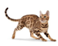
Neural Network
A standard Neural Network :
3 parts: one input layer, one or more hidden layer(s) and one output layer
Layers are connected
Each layer’ neurons use the same activation function
Also refers as a Multilayer Perceptron (MLP)
Dense/Linear layer
More details
Flatten

Slide 20
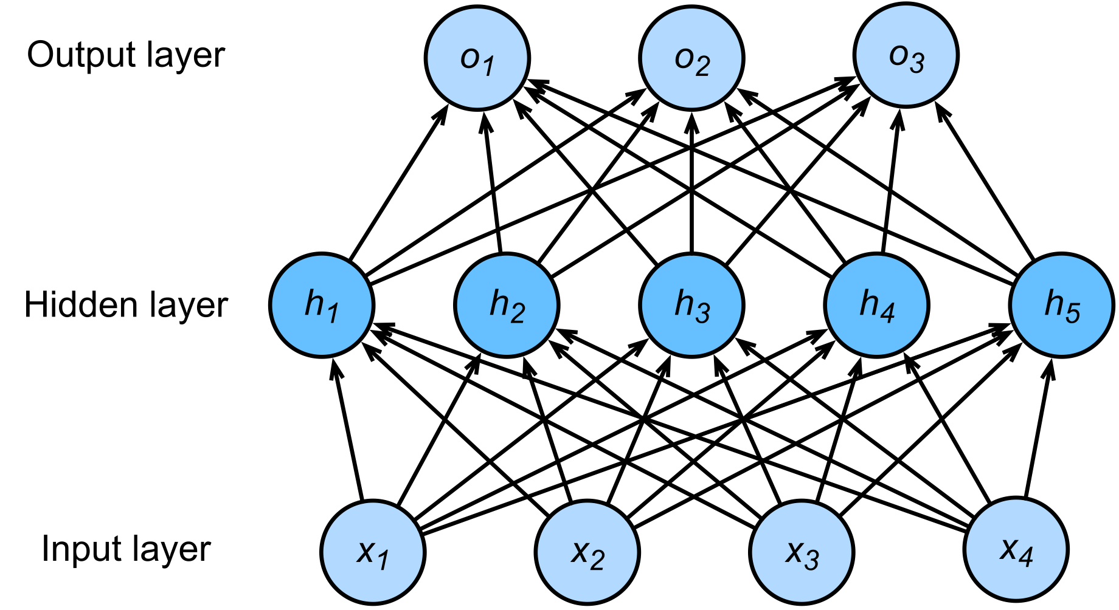
Problem of MLP
To many parameters to train…
# hidden units: 100
# parameters: 100x120,000 =12 million
……
……
# inputs: 200x200x3 =120,000
Flatten
Image Size: 200x200x3

Slide 21
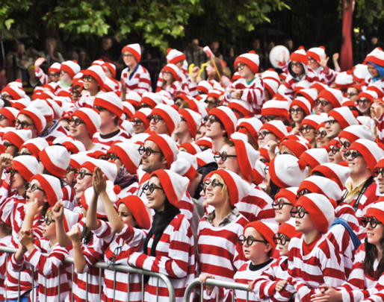

Can we reduce parameters?
Where is Waldo?

Slide 22
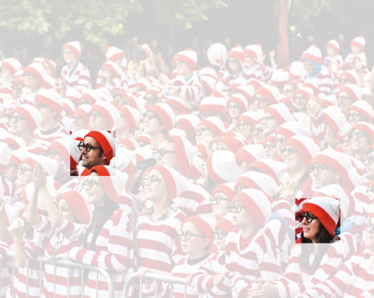
Our vision system…
1. Translation Invariance:
Similar respond to the same object, regardless of its location

Slide 23
Our vision system…
2. Locality:
Focusing on somewhat local regions, rather than a larger scale

Slide 24
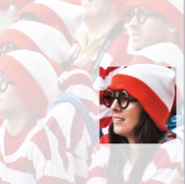
Filters
Each pixel on the image can be realized as $x_{i,j}$
Each “weight” on the filter (or convolution, or kernel) window can be defined by $w_{a,b}$

Slide 25

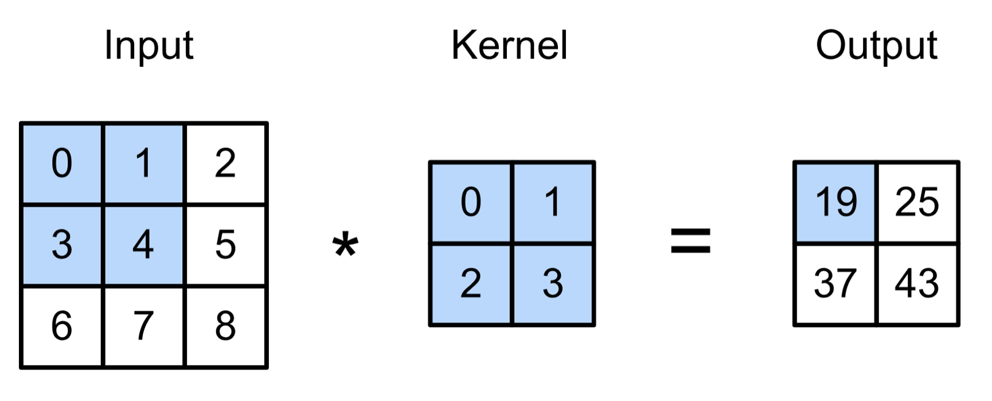
2D Convolution Example
(vdumoulin@ Github)

Slide 26
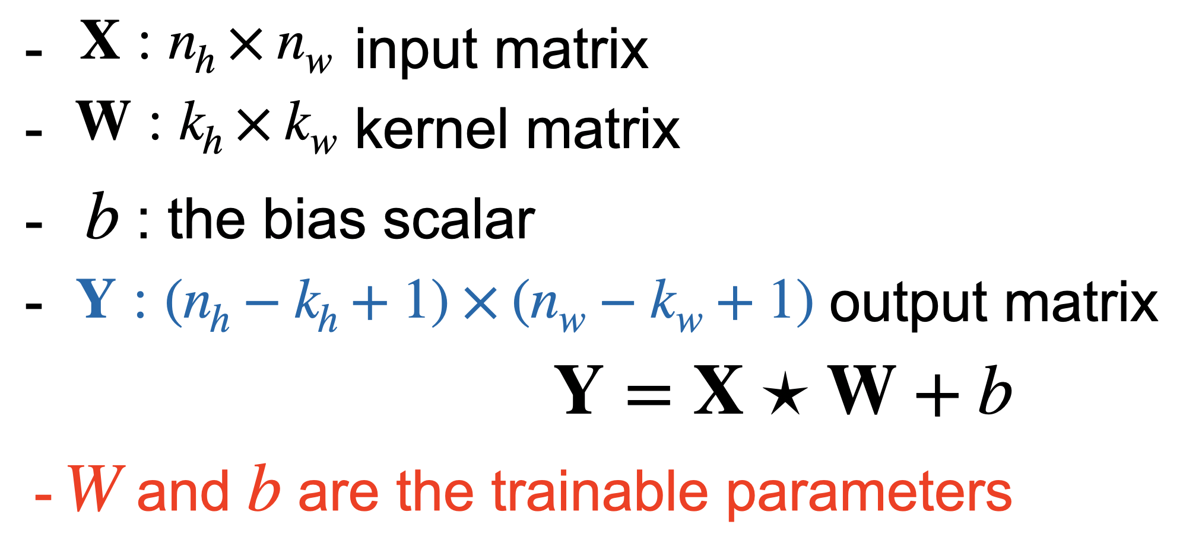
2D Convolution Example
(vdumoulin@ Github)

Slide 27
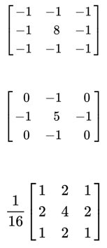
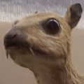
Filters
What will happen after the filters?
(wikipedia)

Slide 28
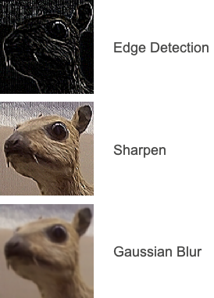
Filters
(wikipedia)

Slide 29

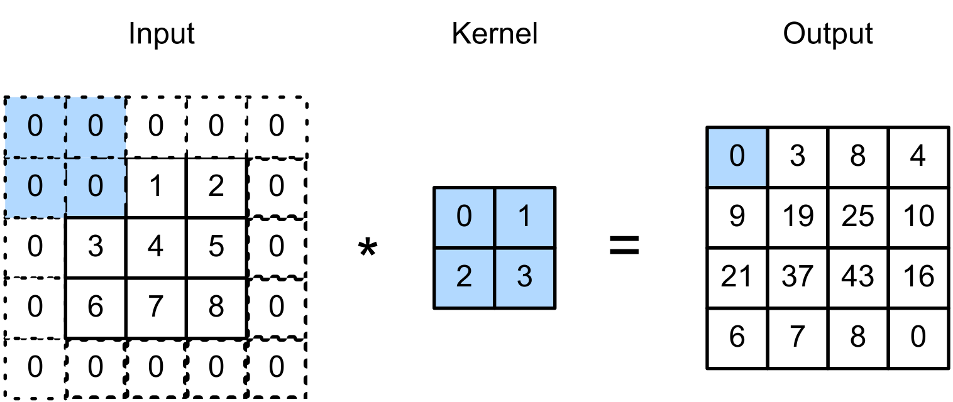
Padding
Padding adds rows/columns around the input.
(vdumoulin@ Github)

Slide 30

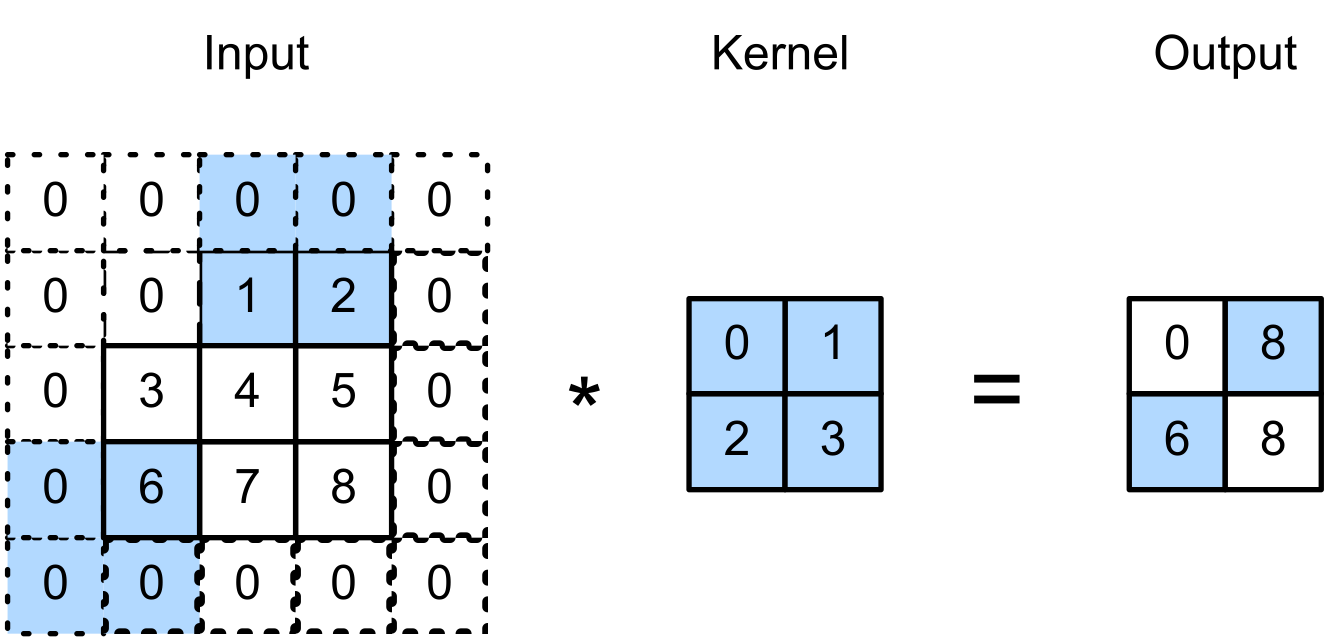
Stride
Stride is the number of “unit” the kernel shifted per slide over rows/columns.
E.g., Strides of 3 for height and 2 for width
(vdumoulin@ Github)

Slide 31
Pooling
Pooling is used to reduce size (h & w) of the feature map.
can operate with padding and stride
no weights to train
Max Pooling: Returns the maximal value in the pooling window
Average Pooling: Returns the average in the window

Slide 32
CNN Layers
(Output)
A simple Convolutional Neural Network (CNN) is usually made of the following layers:
Convolution
Pooling
Dense
(Input)

Slide 33
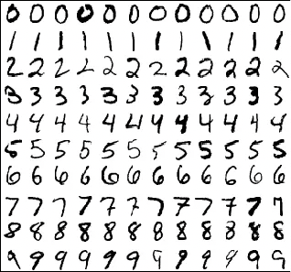
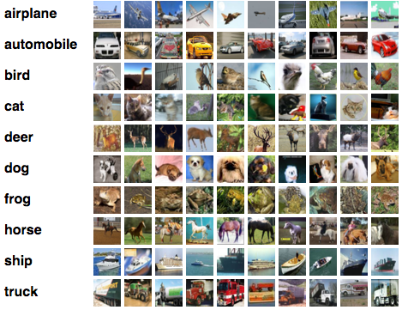
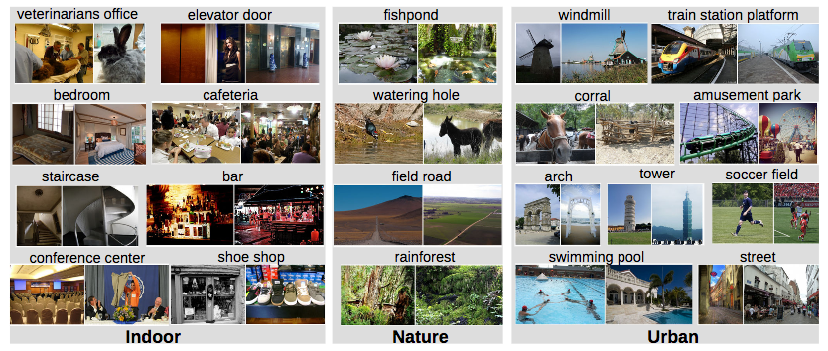
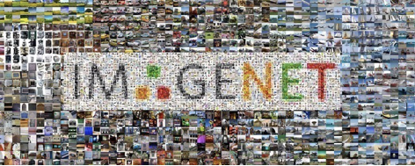
Computer Vision Dataset
A lot of publicly available CV datasets
In academia : for benchmarking
In industry: using as “source” dataset for transfer learning

Slide 34
MNIST*
A dataset of handwritten digits (0,1..,9) images
28 x 28 grayscale
Centered and scaled
50,000 training data
10,000 test data
* LeCun et al. (1999): The MNIST Dataset Of Handwritten Digits

Slide 35
Fashion–MNIST*
A drop-in replacement of MNIST
There are 10 classes; 28 x 28 grayscale; Centered and scaled
60,000 training data and10,000 test data
More details
* Xiao et al. (2017): Fashion-MNIST

Slide 36
CIFAR-10*
A tiny image dataset
32x32 color images
10 classes: 6,000 images per class
50000 training and 10000 test images
Not centered and scaled
More details
* Alex Krizhevsky, Vinod Nair, and Geoffrey Hinton

Slide 37
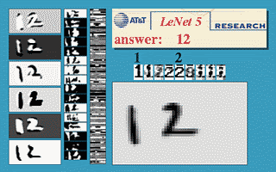
LeNet*
A CNN trained to classify digits (MNIST Dataset)
* LeCun et al., (1998). Gradient-based learning applied to document recognition.

Slide 38
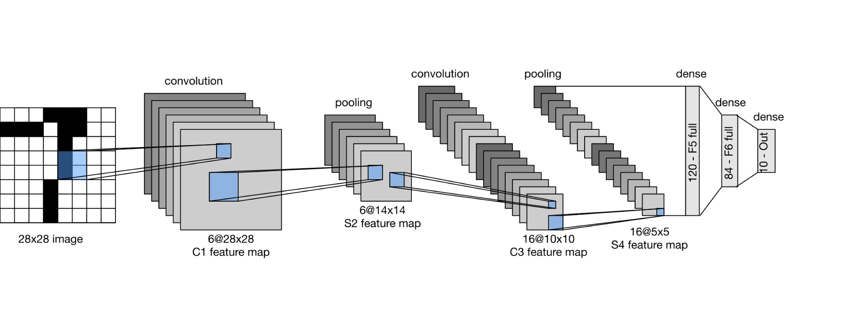
LeNet
LeNet is a five layer convolutional neural network.

Slide 39
AlexNet Summary
A larger and deeper “LeNet”
Dropout, ReLU and preprocessing were the other key steps in achieving excellent performance
~62 Million parameters

Slide 40
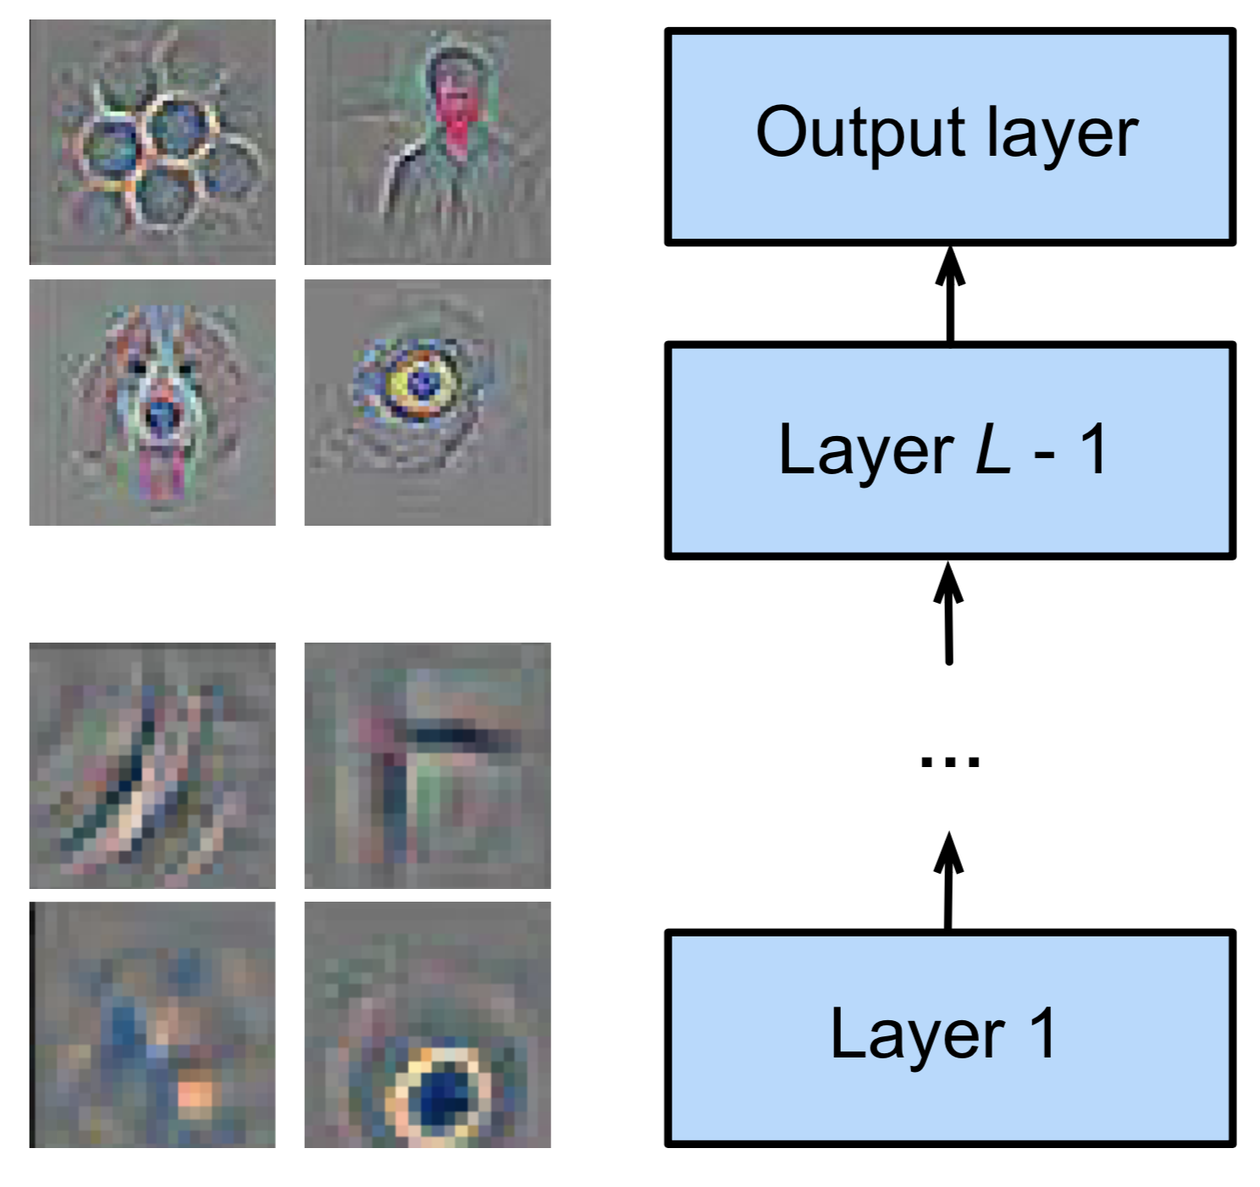
Motivation
Transfer Learning (or Fine-tuning)
Using a pre-trained network and adjust one or more layer(s)
Hierarchical feature representations
Low-level features are universal
High-level features are more related to objects in the dataset

Slide 41
VGG
Multiple VGG blocks followed by dense layers
Feature size: (height x width) x channels:
(224x224) x 3 -> (7x7) x 512 -> (1x1) x 1000
Simonyan & Zisserman, 2014

Slide 42
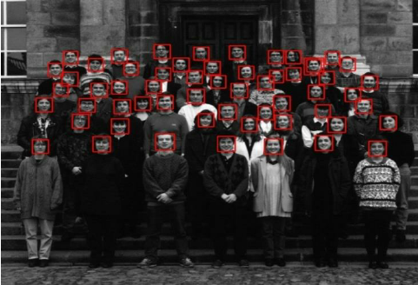
Object Detection Examples
Face Detection
* P. Viola and M. Jones. (2001): Robust real-time object detection.

Slide 43
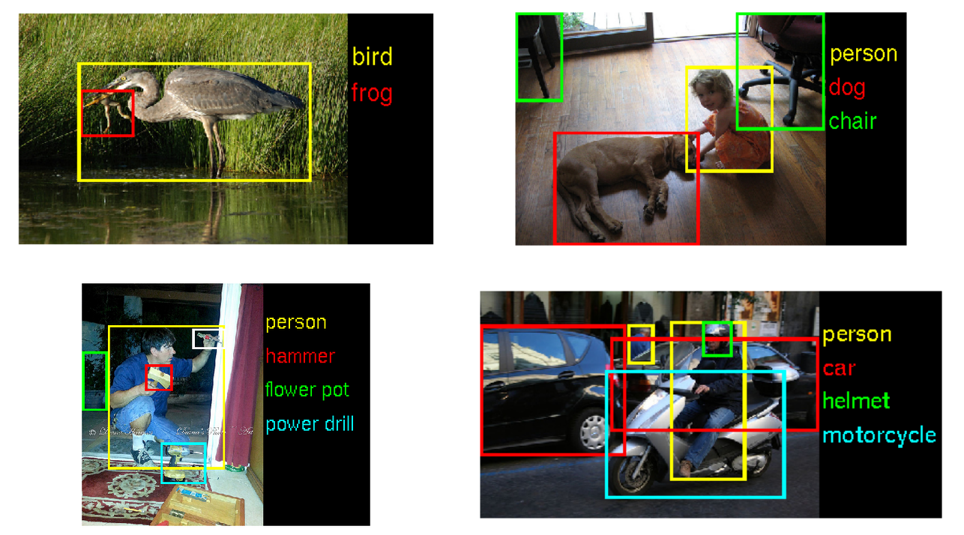
Object Detection Examples
More examples from the ImageNet Large Scale Visual Recognition Competition - ILSVRC

Slide 44
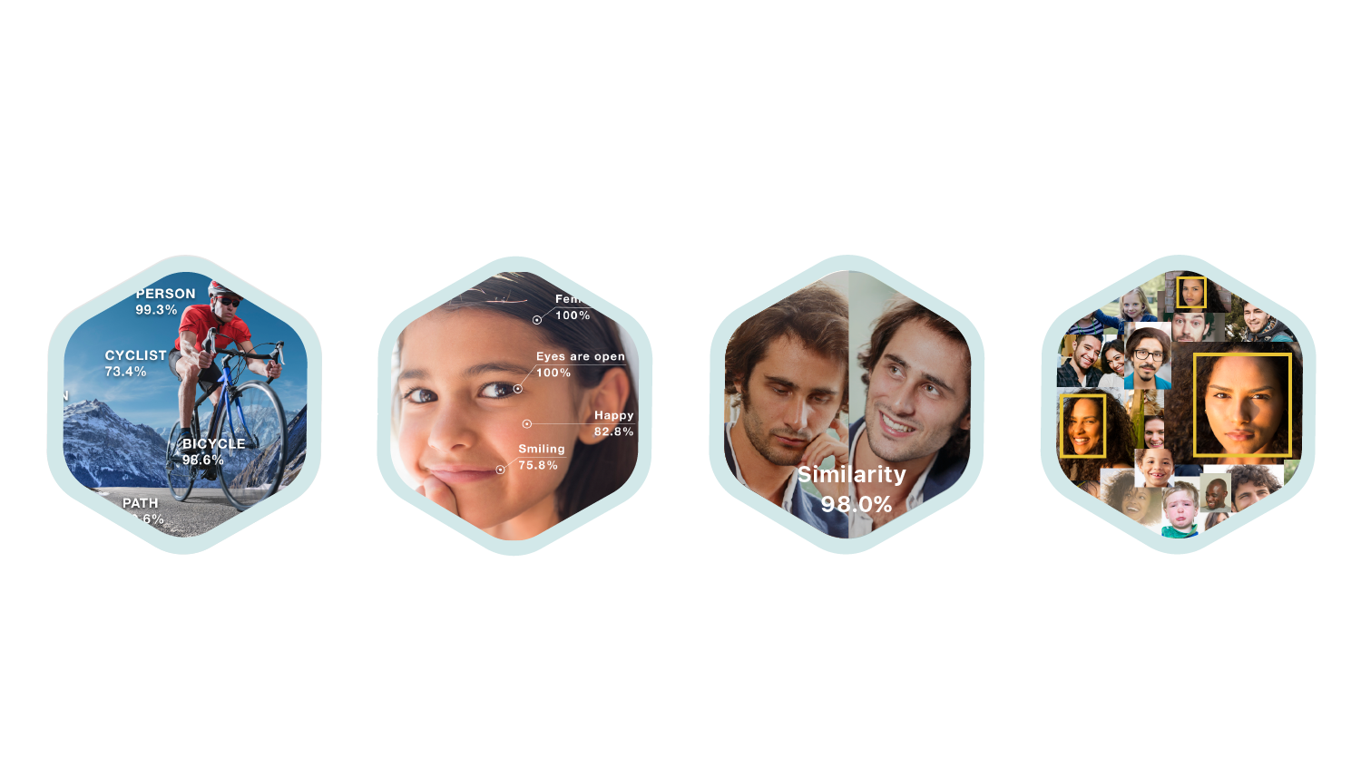
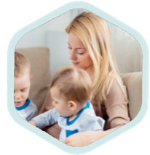

Object Detection at Amazon
Amazon Rekognition Image: a deep learning powered image recognition service
Object and Scene Detection
Face Analysis
Face Recognition
Face Comparison
Celebrity Recognition
Text in Image

Slide 45
Object Detection at Amazon
AmazonGo: purchase products without being checked out

Slide 46
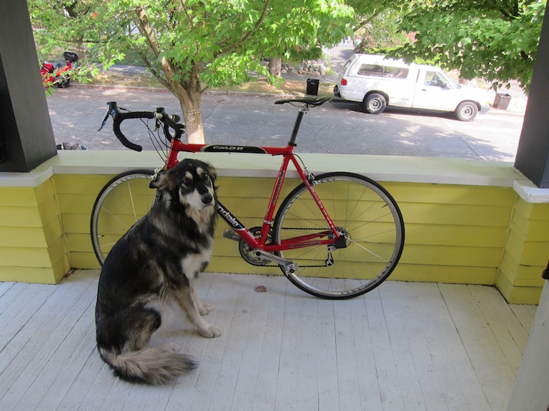
Bounding Box
To detect object/target locations
Determined by 2 (x, y) axis coordinates
upper-left corner
lower-right corner

Slide 47
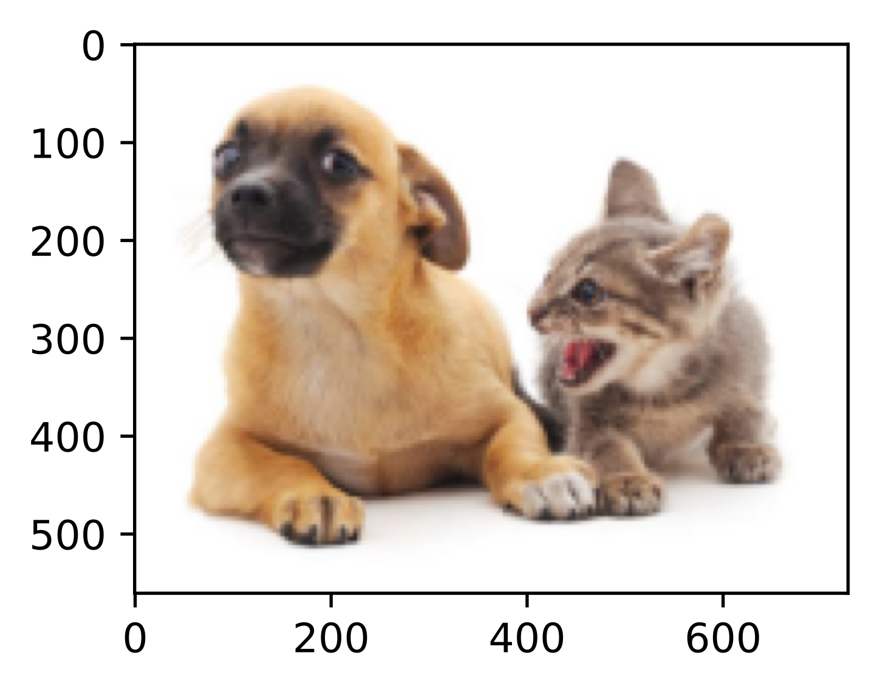
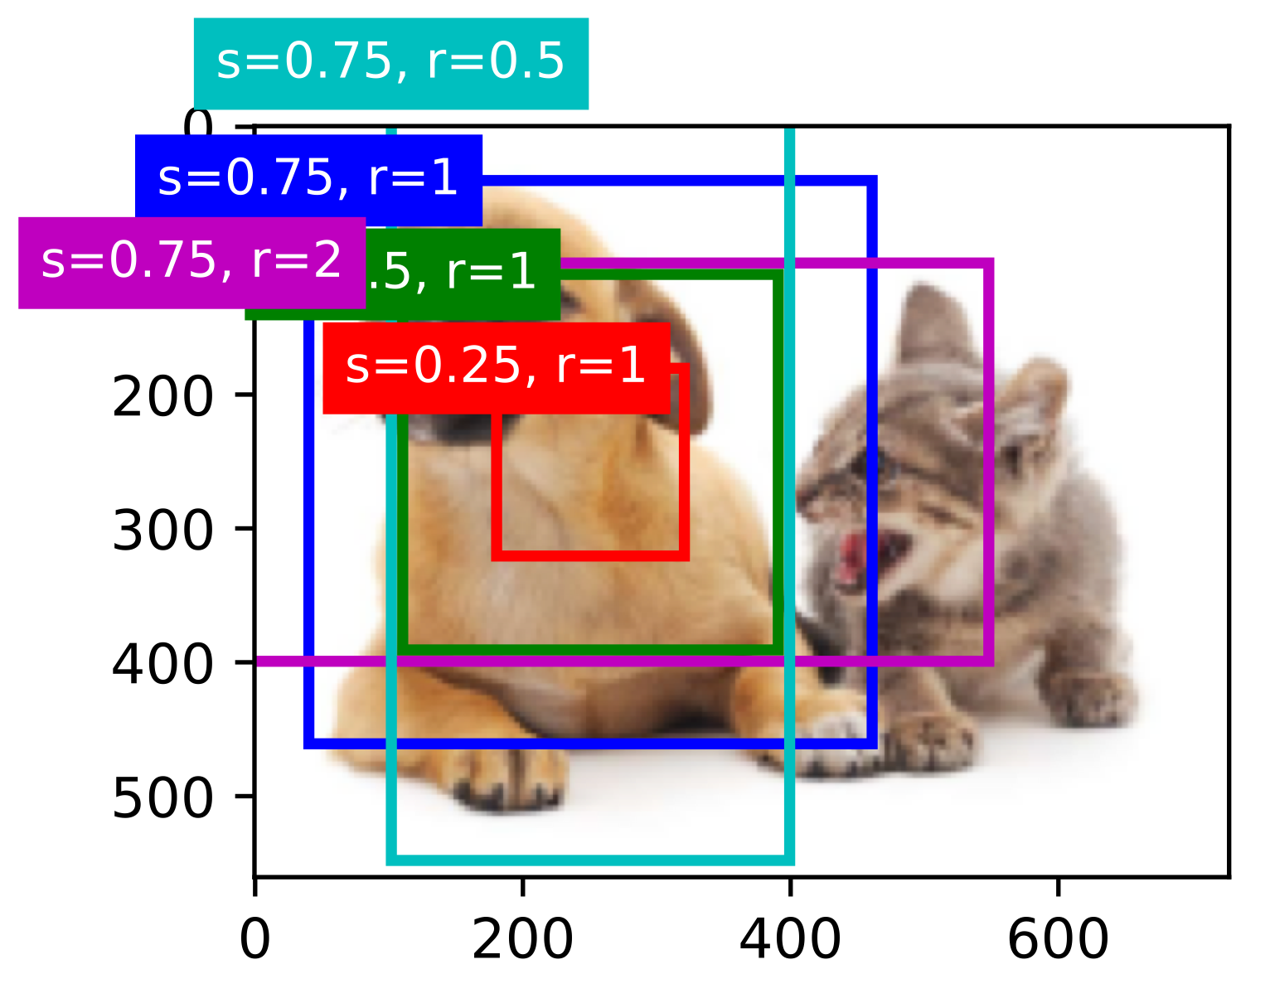
Anchor Box
Anchor boxes: multiple bounding boxes with different sizes and aspect ratios while centering on each pixel

Slide 48
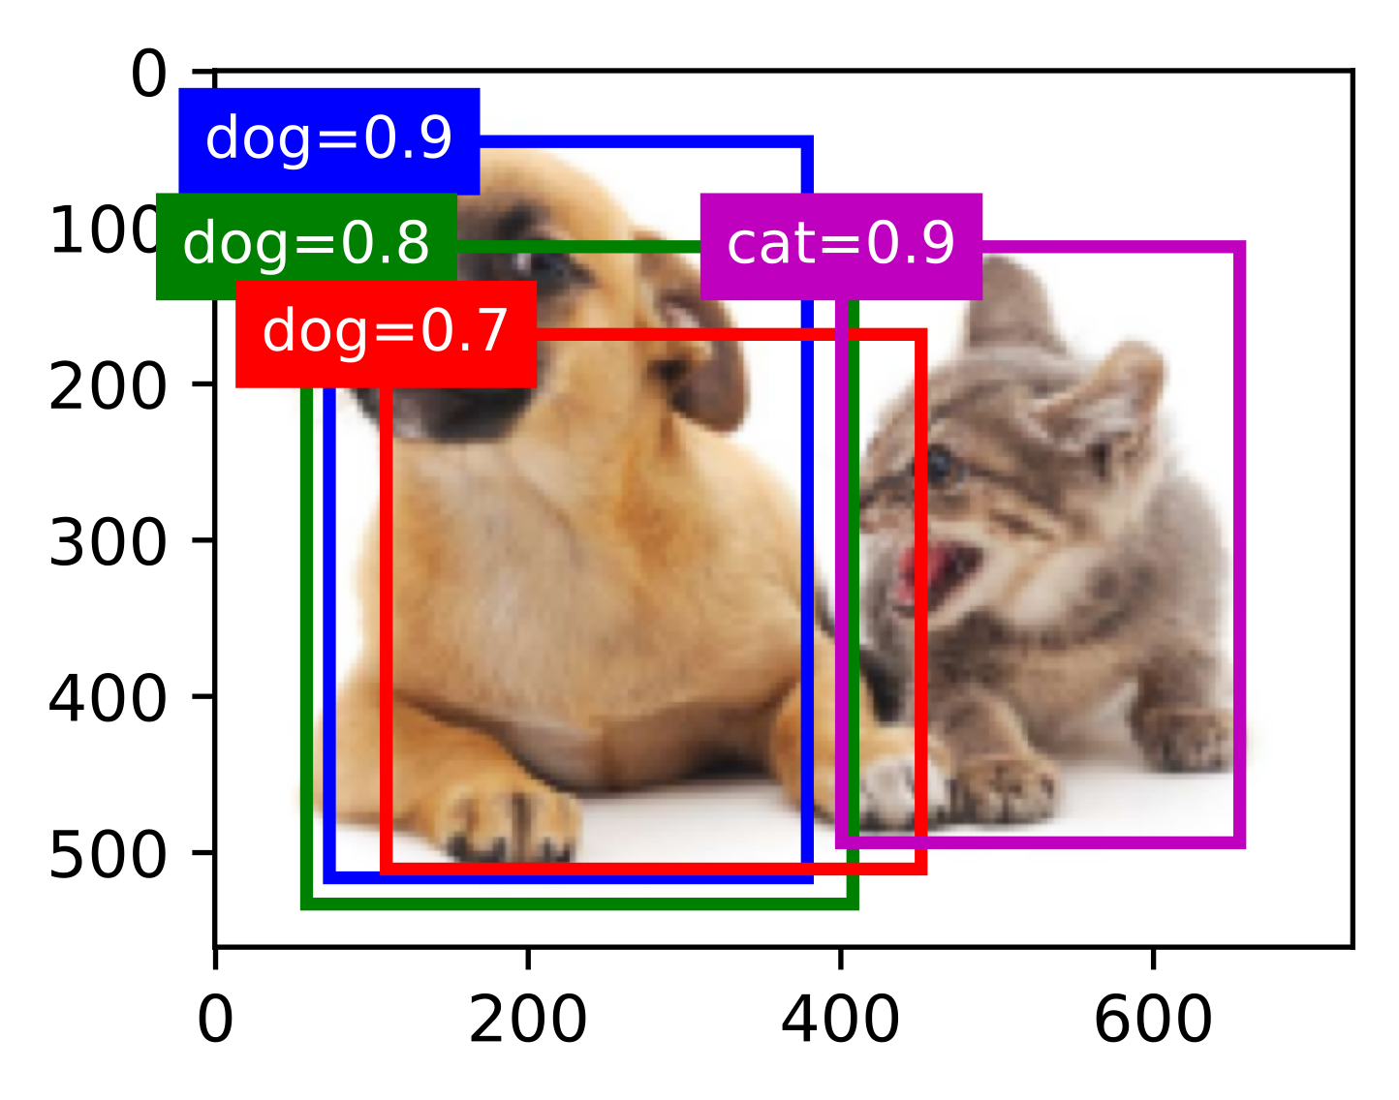
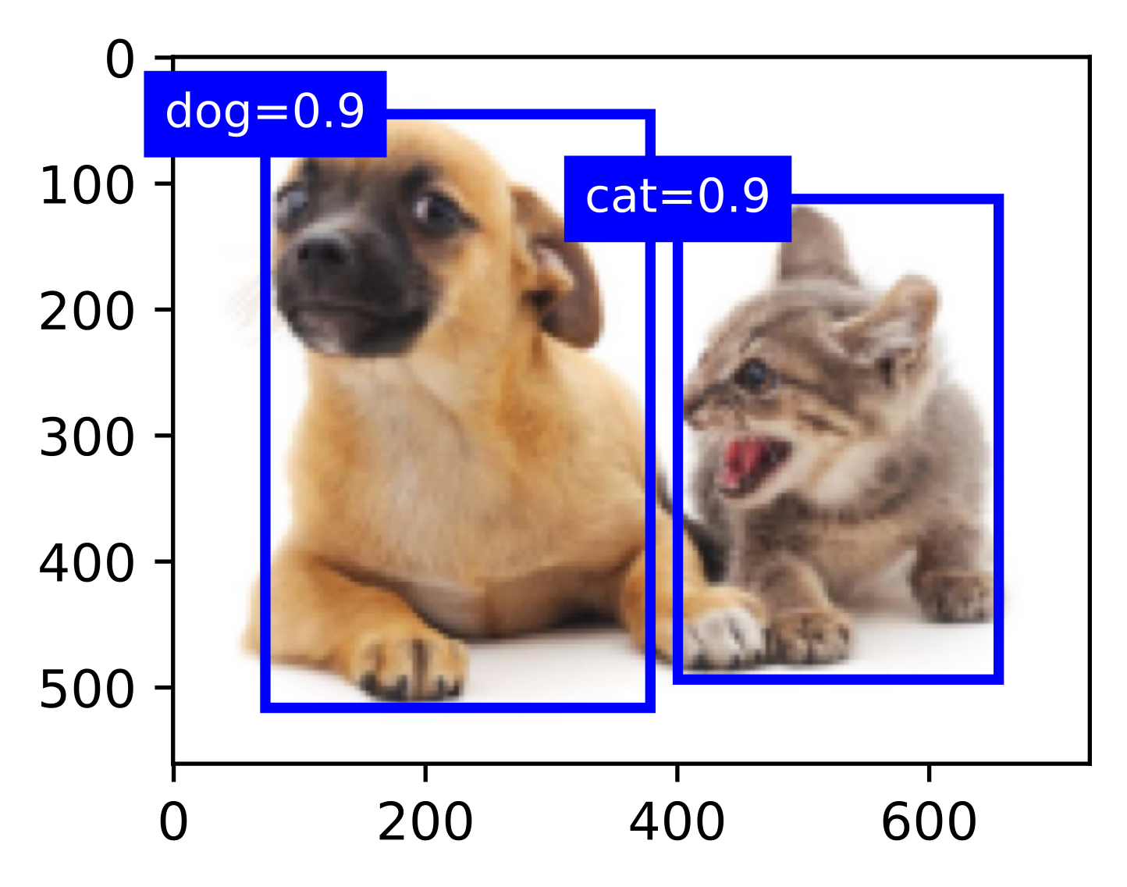
Sliding Window Summary
Steps:
Use a sliding window with anchor boxes
Run through every window location and decide the class for that window
Greedily remove/select boxes using Non-max suppression

Slide 49
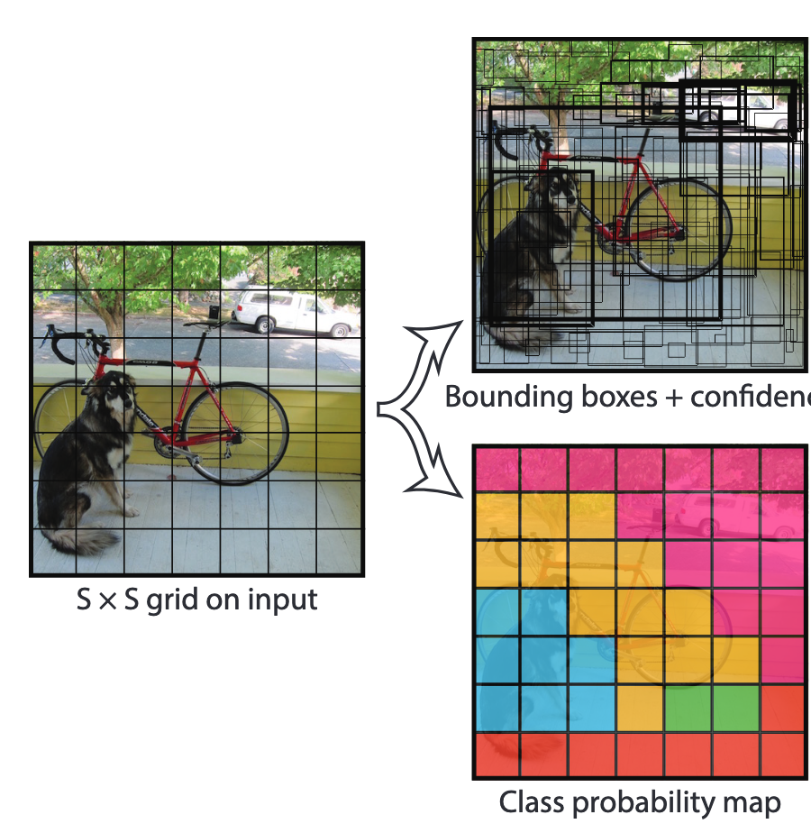
YOLO (You Only Look Once)
Output shape of YOLO:
7 X 7 x ( 2 x 5 + 20) = 7x7x30
2 boxes per cell
20 object classes:
[c₁ , c₂ , …, c₂₀]
Bounding box values:
[P_{C} , b_{x} , b_{y} , b_{h} , b_{w} ]

Slide 50
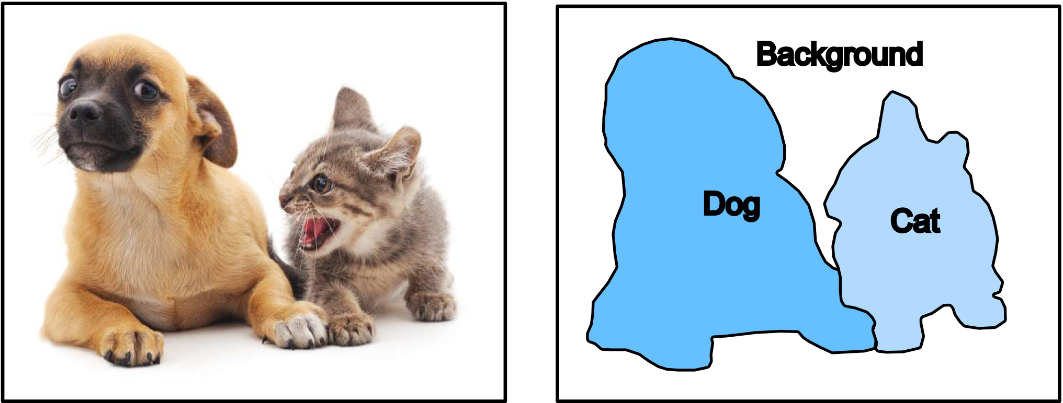
Semantic Segmentation
Semantic Segmentation divides the image into different semantic regions by transforming image pixels to pixel categories.

Slide 51
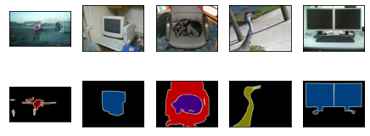
Pascal Visual Object Classes (VOC)
Pascal VOC is a benchmarking dataset for segmentation tasks.
~10k images with segmentation classes
20+1 classes: (‘background’,) 'aeroplane', 'bicycle', 'bird', 'boat', 'person’, etc.
Sample segmentation images (background is black)

Slide 52
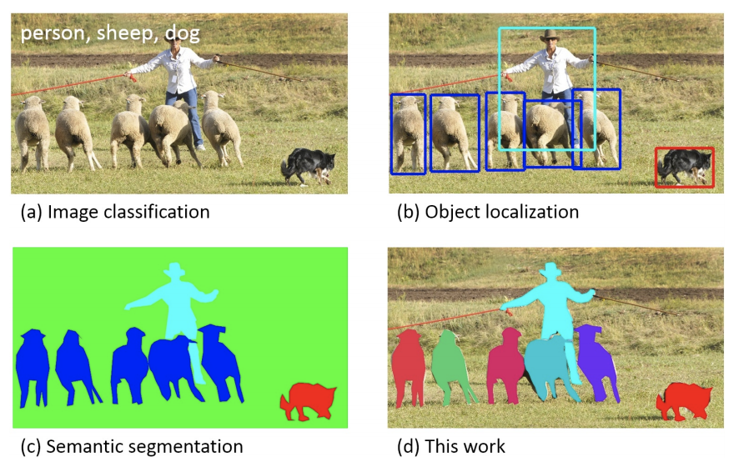
COCO
COCO (Common Objects in Context) is a large-scale object detection, segmentation, and captioning dataset:
330K images (>200K labeled)
1.5 million object instances
80 object categories

Slide 53
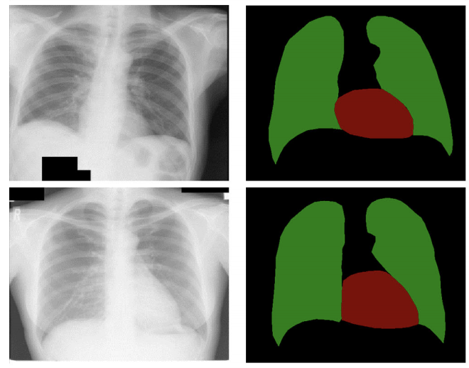
Semantic Segmentation Applications
https://www.researchgate.net/publication/318511415_Medical_image_semantic_segmentation_based_on_deep_learning
https://gluon-cv.mxnet.io/

Slide 54
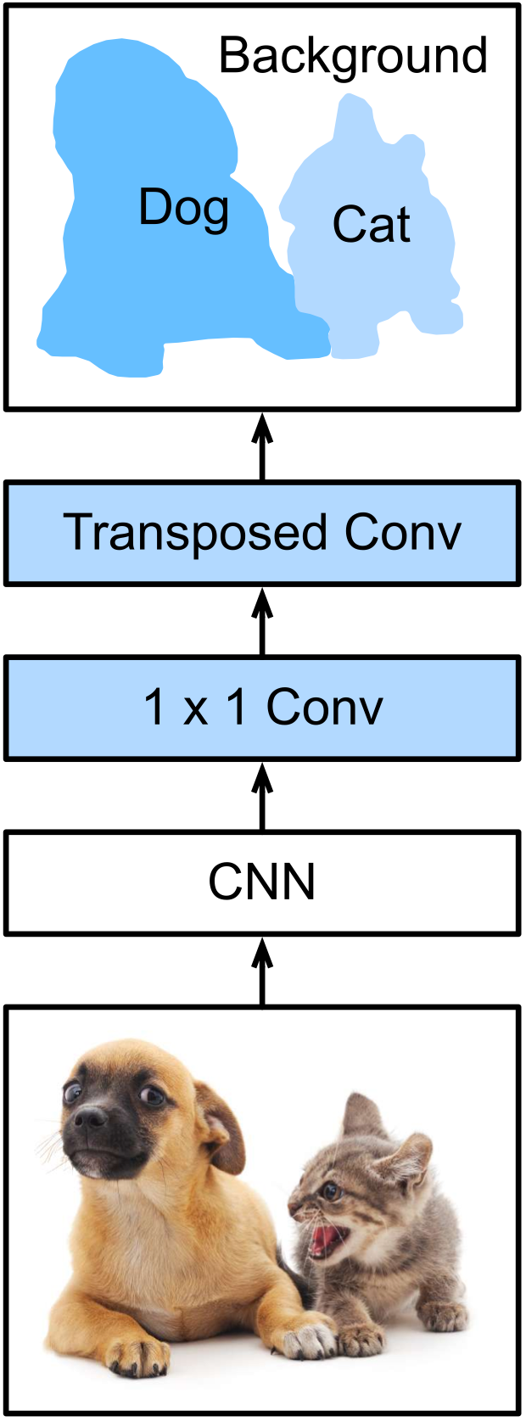
Fully Convolutional Neural Network (FCN)*
Two folds:
CNN shrinks features to shape of ”1x1xchannel“
Upsampling outputs the semantic segmentation mask
E.g., Transposed Convolution
Applying softmax at the end for pixel classification
Pixel classes (softmax)
Size: N x M
Upsampling by 32
Feature pooling
Size: (N/32 x M/32)
Feature map
Size: (N/32 x M/32 x C)
Input image
Size: NxMx3
* Long, J., Shelhamer, E., & Darrell, T. (2015).

Slide 55
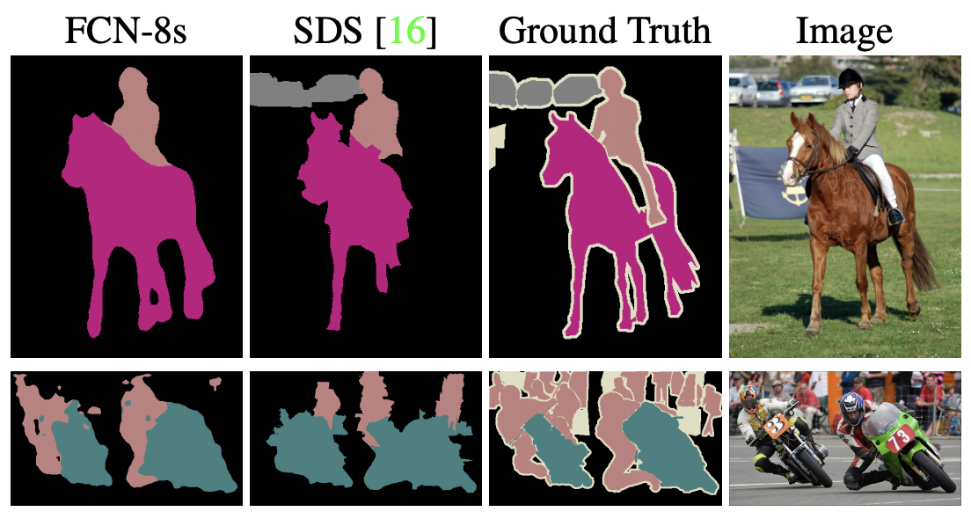
FCN Results on VOC
Common evaluation metrics: Pixel accuracy, mean IoU
Some results from VOC:
More Details.

Slide 56
MLA CV Thank you!

